Slide 1
Intro to Coding with Python– More Functions
Dr. Ab Mosca (they/them)
Slides based off slides courtesy of Jordan Crouser (https://jcrouser.github.io/)

Slide 2
Plan for Today
Recap defining and calling functions
String functions together

Slide 3
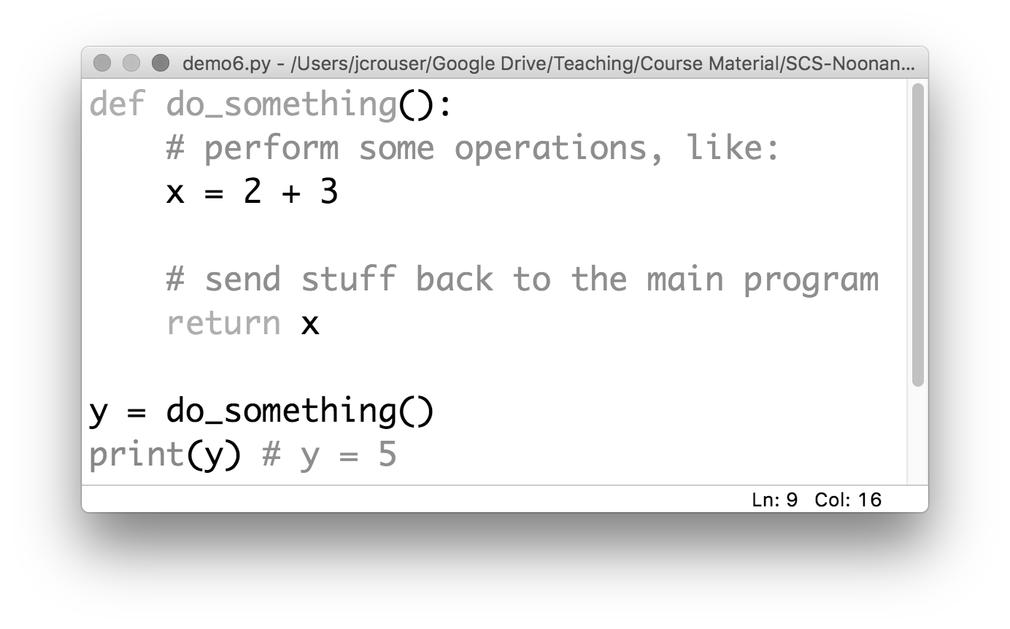
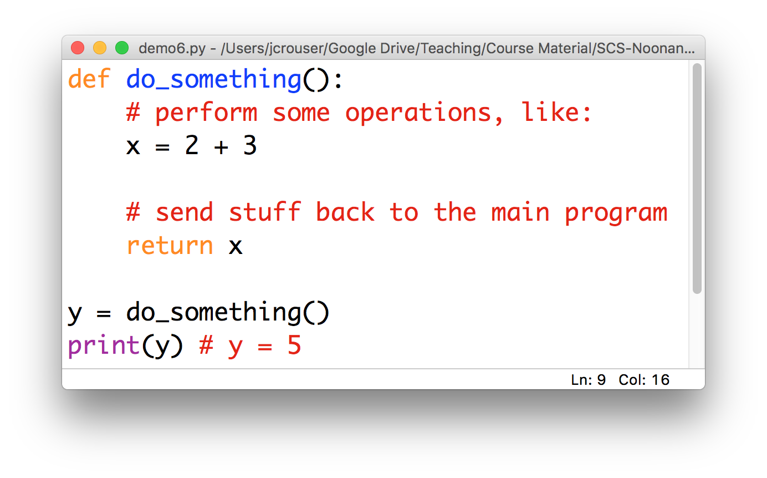
To recap: a “function definition”

Slide 4
To recap: a “function definition”
a name
Convention: use _underscores_ or camelCase

Slide 5
To recap: a “function definition”
defined using
the def keyword

Slide 6
To recap: a “function definition”
a body
(indented)

Slide 7
To recap: a “function definition”
a return (optional)

Slide 8
To recap: function calls
a function call

Slide 9
To recap: function calls
5

Slide 10
Definitions vs. calls
Function Definition
Function Call
Step-by-step instructions for how to perform a given set of operations
Analogy: a recipe
Think of the function’s name as shorthand (i.e. “okay, when I say do_something(), here’s what I want you to do”)
An actual request to perform the operations
Control is turned over to the “minion” (temporarily)
Once complete, we go back to the exact place in the program where the call was issued

Slide 11
Discussion
What does it mean for a function
to return a value?
And what’s the difference
between return and print(…)?

Slide 12
Notes:
Print versus return -- use 2 functions!

Slide 13
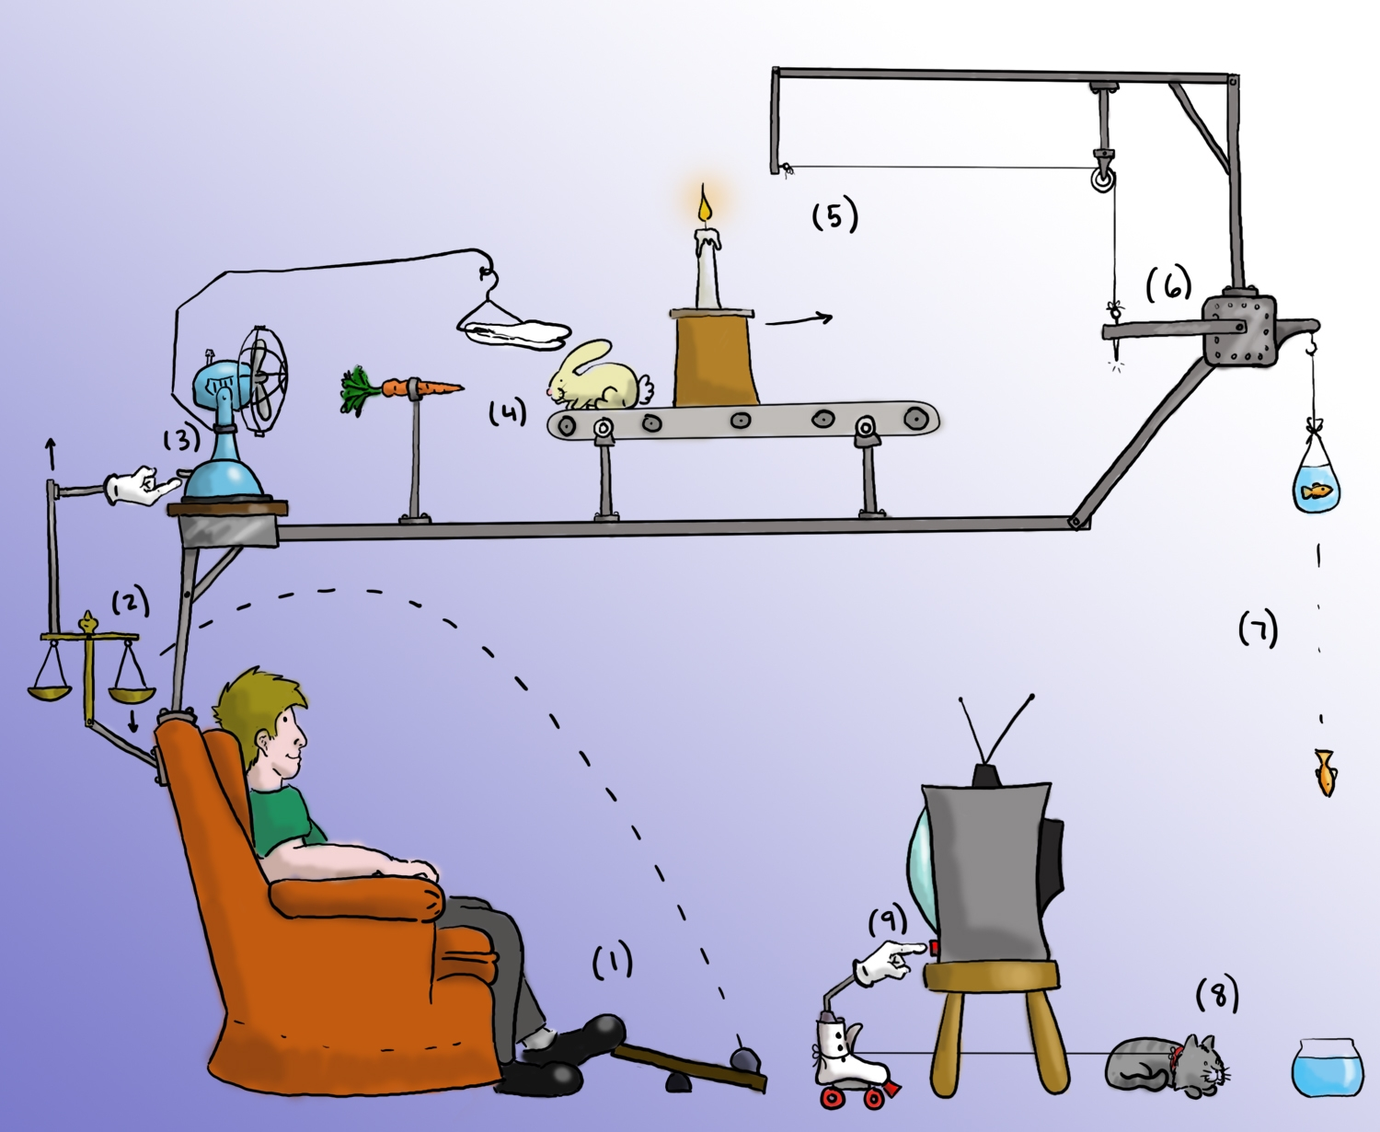
Demo: Rube Goldberg machine
“Remote” - by philister

Slide 14
def addOne(x):
Take the value of x, and add 1 to it
return the modified value

Slide 15
def doubleIt(x):
Take the value of x, and double it (i.e. multiply by 2)
return the modified value

Slide 16
def printWithStars(x):
Look at the value of x
Print it out as *’s (i.e. if x = 3, print ***)
return nothing

Slide 17
def woohoo():
Print “WOO HOO!”
Call printWithStars(addOne(doubleIt(2)))
return nothing

Slide 18
Discussion
Lingering questions?

Slide 19
